Slide 1
Airline Booking System
Mini Project CSE – 4A
Group no – A2

Slide 2
Introduction:
“Airline Reservation System” project is an attempt to stimulate the basic concepts of airline reservation system. The system enables the customer to do the things such as search for airline flights for two travel cities on a specified date, choose a flight based on the details, reservation of flight and cancellation of reservation.

Slide 3

AIRLINE RESERVATION SYSTEM:
The main purpose of this software is to reduce the manual errors involved in the airline reservation process and make it convenient for the customers to book the flights as when they require such that they can utilize this software to make reservations, modify reservations or cancel a particular reservation.

Slide 4
FEATURES OF BLOG APP:
● Free Account
● Selection among
● Large no of Airways
● Full detailed Flights
● Easy to Get Flights
● Easy to edit and view your Personal Information
● Secure
● User Friendly

Slide 5
How its Build:
It is build in Python programming language using tkinter (GUI library in Python)
Database we use to store the Userdata is Sqlite3

Slide 6

Python:
Python is a high-level, interpreted, interactive and object-oriented scripting language. Python is designed to be highly readable. It uses English keywords frequently where as other languages use punctuation, and it has fewer syntactical constructions than other languages.
● Python is Interpreted
● Python is Interactive
● Python is Object-Oriented
● Python is a Beginner's Language

Slide 7
About Python:
Python was developed by Guido van Rossum in the late eighties and early nineties at the National Research Institute for Mathematics and Computer Science in the Netherlands.

Slide 8
Python Features:
● Easy-to-learn
● Easy-to-read
● Easy-to-maintain
● A broad standard library
● Interactive Mode
● Portable
● Extendable
● Databases.

Slide 9
Tkinter Programming:
Tkinter is the standard GUI library for Python. Python when combined with Tkinter provides a fast and easy way to create GUI applications. Tkinter provides a powerful object-oriented interface to the Tk GUI toolkit.
Tkinter Widgets:
Tkinter provides various controls, such as buttons, labels and text boxes used in a GUI application. These controls are commonly called widgets.

Slide 10
Creating a GUI application using Tkinter is an easy task. All you need to do is perform the following steps
● Import the Tkinter module.
● Create the GUI application main window .
● Add one or more of the above-mentioned widgets to the GUI application.
● Enter the main event loop to take action against each event triggered by the user.
Example:
#!/usr/bin/python
import Tkinter top = Tkinter.Tk()
# Code to add widgets will go here...
top.mainloop()

Slide 11

Sqlite3:
● SQLite is a C library that provides a lightweight disk-based database that doesn‟t require a separate server process and allows accessing the database using a nonstandard variant of the SQL query language.
● It‟s also possible to prototype an application using SQLite and then port the code to a larger database

Slide 12
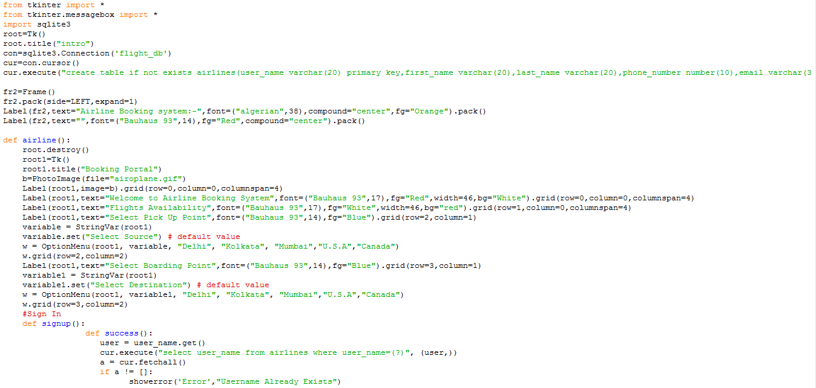
Source Code:

Slide 13
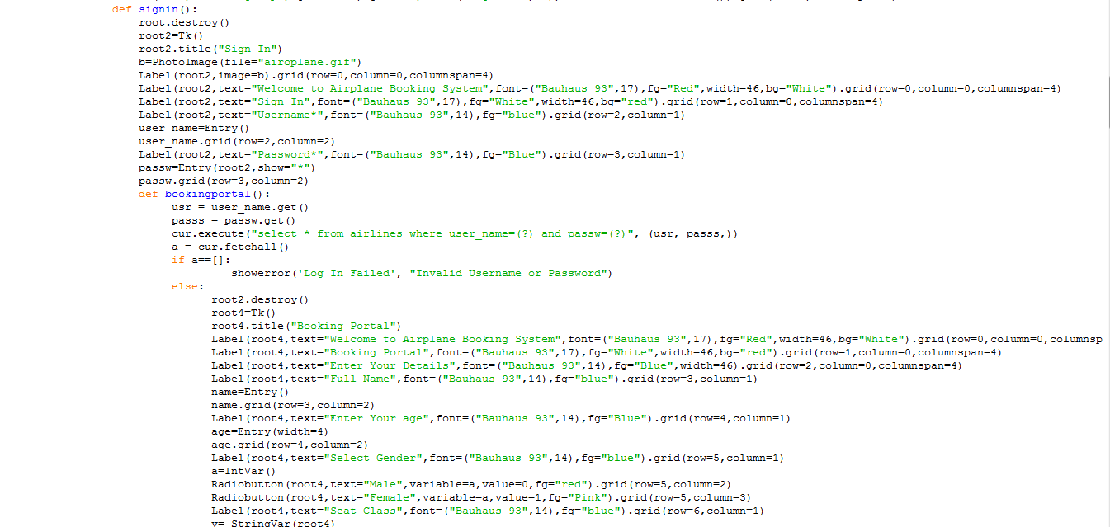

Slide 14
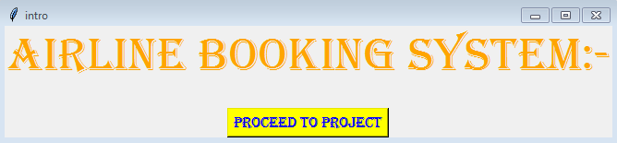
Output:
Step 1:-

Slide 15
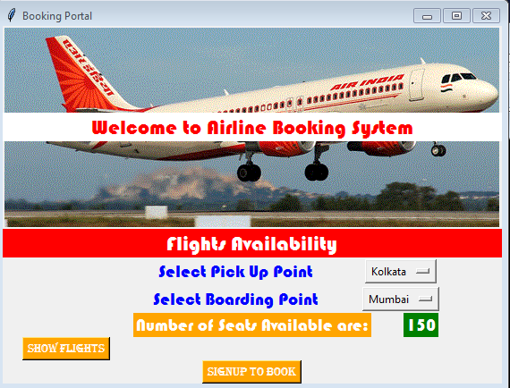
Output:
Step 2:-

Slide 16
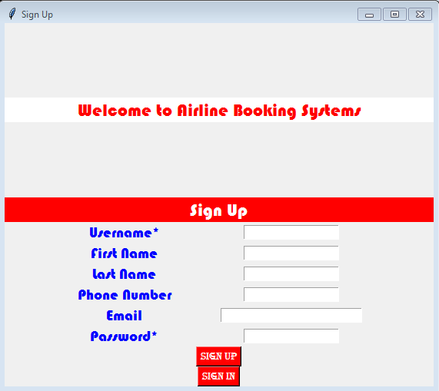
Output:
Step 3:-

Slide 17
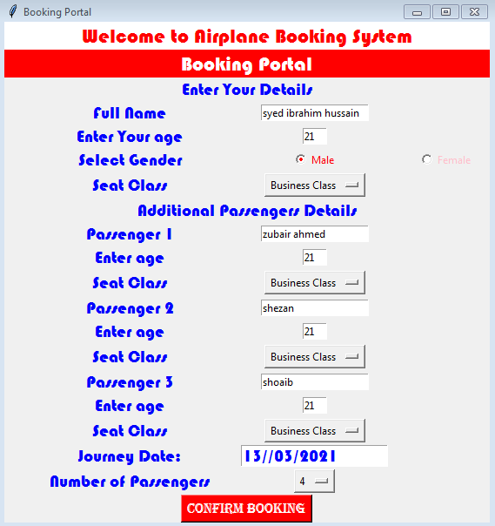
Output:
Step 4:-

Slide 18
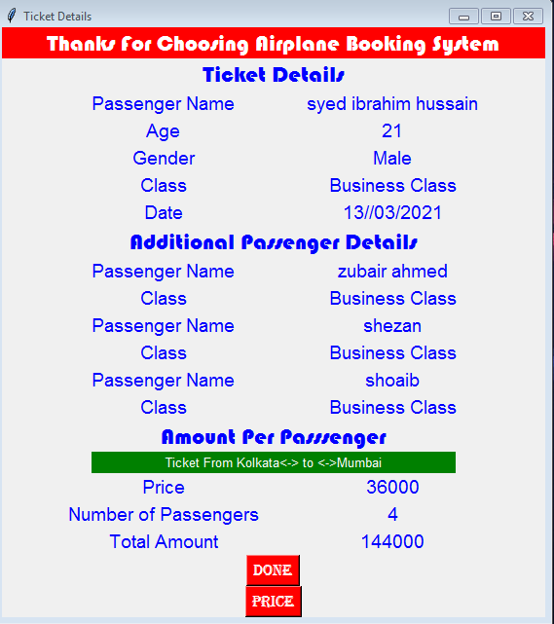
Output:
Step 5:-

Slide 19
CONCLUSION
While making the system, an eye has been kept on making it as user-friendly. As such one may help that the system will be acceptable to any user and will adequately meet his/her needs. As in case of any system development process where there are a number of short comings, there have been some shortcomings in the development of this system also.

Slide 20
Thanks
The End

